Slide 1
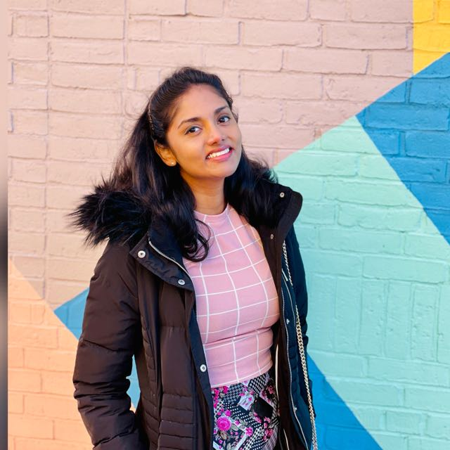
Aishwarya Vantipuli
Masters in Data Science

Slide 2
Intro
Projects
Work experience
Motivation
AGENDA

Slide 3
Science fiction
Gaming
Learning
About Me:
Hi! I'm Aishwarya.
I love crunching numbers and playing with the data.
Notes:
Hello there! I'm Aishwarya. I love crunching numbers and playing with the data. I'm fascinated by the idea of capturing and transforming data into numbers, numbers into words, words into stories and stories
into actions to make the world a better place. A few interesting things about me... I love to watch science fictions (Christopher Nolan's movies are my favorite). I am also an avid gamer. I love to play competitive strategy games and first-person shooters. Lastly, I love learning. Every day I push myself to learn something new, whether that be about machine learning, software engineering, or miscellaneous facts about the universe.

Slide 4
About Me
Northeastern University
SAP
YOUNIFY
Notes:
I am a recent graduate from Northeastern University with Masters degree in Data Science. I have 2 years of experience in the field of Data Science/Computer Vision and worked as a Data Science Intern at SAP. I am actively looking for full time opportunities in Data Science, Machine Learning, Data Engineering, Data Analyst and Software Engineering.

Slide 5
Education
Probability & Statistics
Linear Algebra
Machine Learning
Deep Learning
Algorithms & Data Structures
Database Management Systems

Slide 6

Technologies

Slide 7
TECHNICAL KNOWLEDGE
➤ Languages: R, Python, C, Java, HTML, CSS, XML
➤ IDE/Tools: Power BI, Tableau, AWS, EC2, Lambda, Git, Kafka, Apache Spark, Elastic Search
➤ Libraries/Packages: NumPy, Pandas, Scikit-learn, Matplotlib, TensorFlow, PyTorch
➤ Databases: MYSQL, MongoDB, DynamoDB, Hive, Cassandra

Slide 8
𝗗𝗮𝘁𝗮 𝗦𝗰𝗶𝗲𝗻𝗰𝗲:
➤ Machine Learning - Linear/Logistic Regression, Clustering, SVM, KNN, Regularizations, Auto Encoders ➤ Computer Vision - Image Classification, Object Detection, Semantic Segmentation, Image Reconstruction ➤ NLP - Named Entity Recognition, Sentiment Analysis, RNN , LSTM, Machine Translation, Speech Recognition

Slide 9

Work Experience

Slide 10
SAP America
Data Science, Intern
➤ Programmed time series ARIMA models for analyzing and forecasting sales of several consumer products at large scale retail organizations.
➤ Extracted meaningful business insights from data and identify the stories behind the patterns, distilling complex analysis, and concepts into concise business-focused takeaways using Tableau.
➤ Investigated new technologies and methods across data science, ML, and data engineering to improve technical capabilities such as detecting/correcting invalid physical addresses.

Slide 11
Northeastern University
Research Scientist
➤ Engineered a wireless charging device for Electronic Vehicles (EVs) in Embedded Systems powered by Artificial Intelligence.
➤ Generated on-board device’s heatmaps using LSTM+CNN Time-Series model given input signal distributions; eliminated noisy frequencies using Custom Low Pass Filters and Fast Fourier Transforms.
➤ Implemented data generation using GANs, VAEs to extend model to new devices and positions and reduce data collection time by 65%

Slide 12
Younify
Data Scientist
➤ Proposed Business insights for NISSAN using Instagram Analytics. Data is extracted using Instagram API.
➤ Maintained an Image Recognition Application for Image organization and classification of photo libraries using Computer Vision and Keras which helped in attracting and retaining customers.
➤ Designed an Interactive chatbot using Google Dialog Flow. Increased bot’s performance by 60% by integrating various APIs and Machine Learning to give best user experience.

Slide 13

Projects

Slide 14
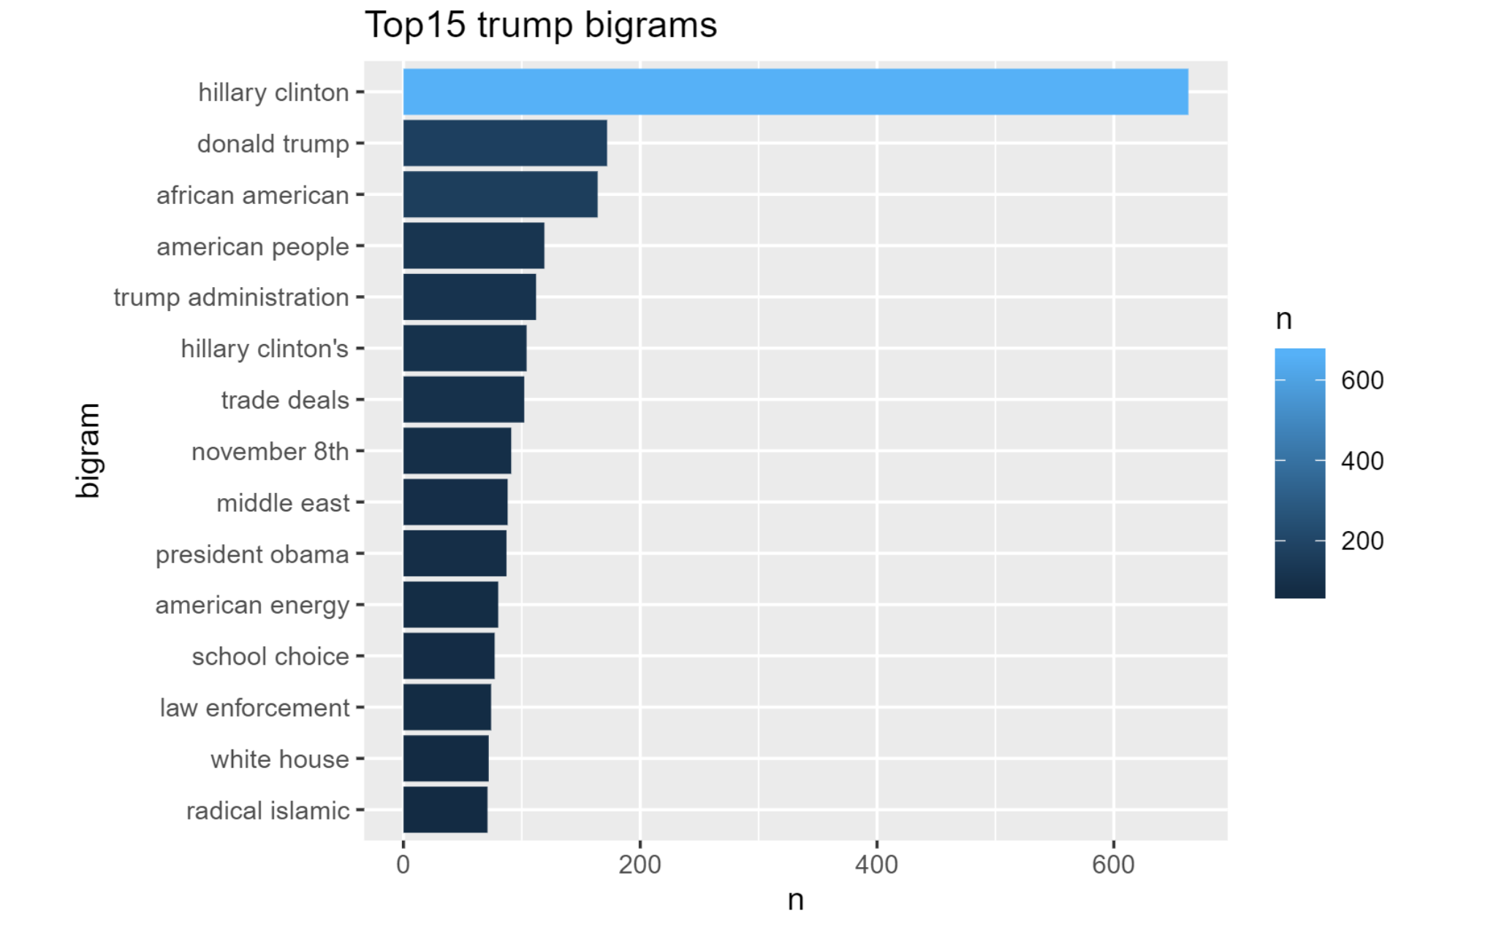
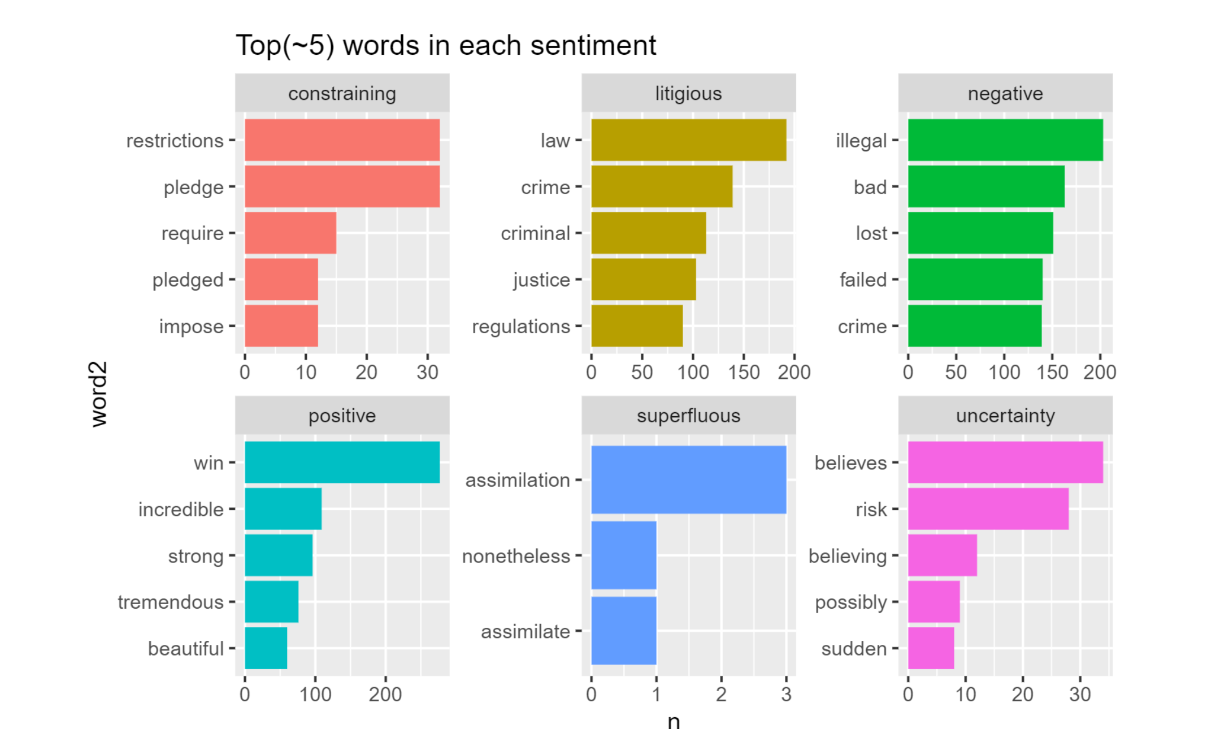
Trump Speech Analysis
Conducted Sentiment Analysis on Trumps Speeches. Observed Trends along different timeframes and visualized the data

Slide 15
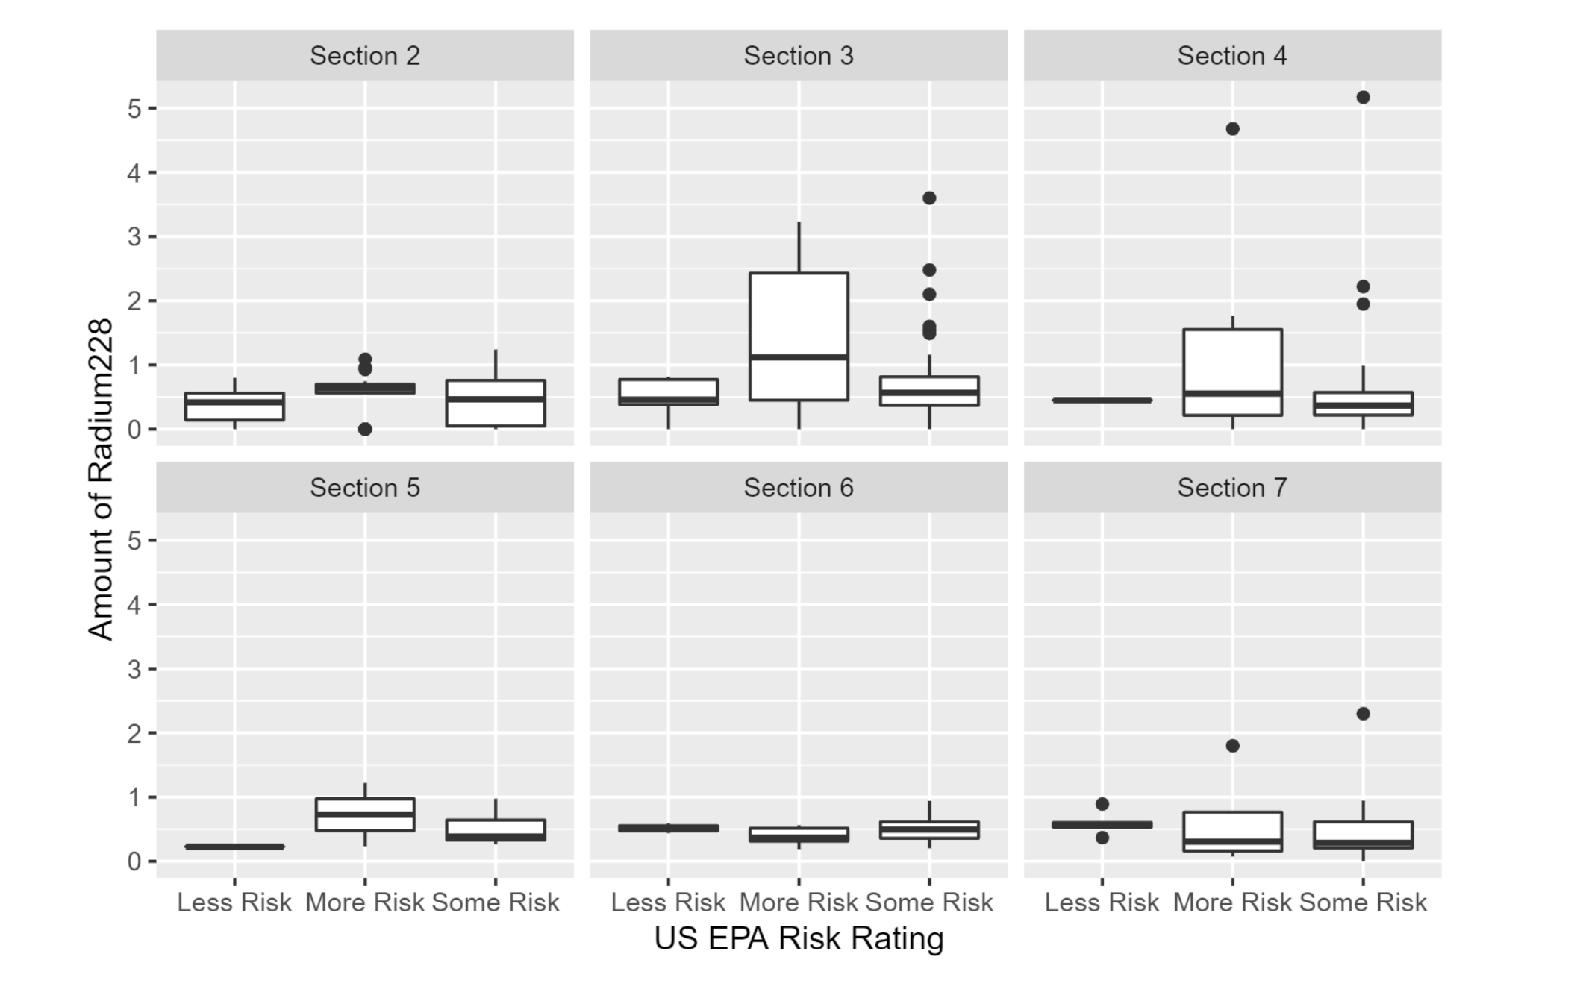
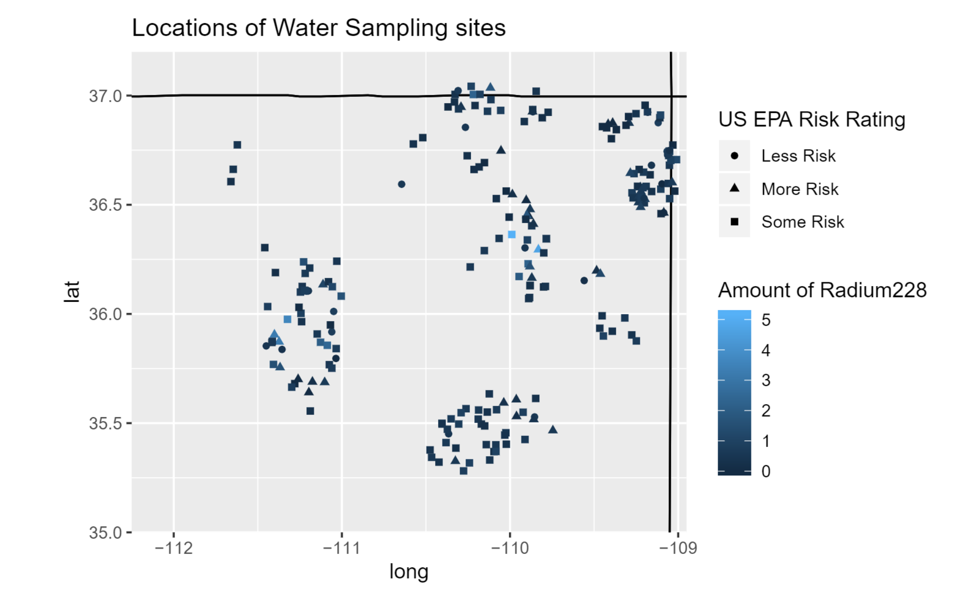
Navajo Nation Water Quality
Visualized presence of different types of radioactive materials in American Indian reservoirs in the southwestern United States and determined their risk levels

Slide 16
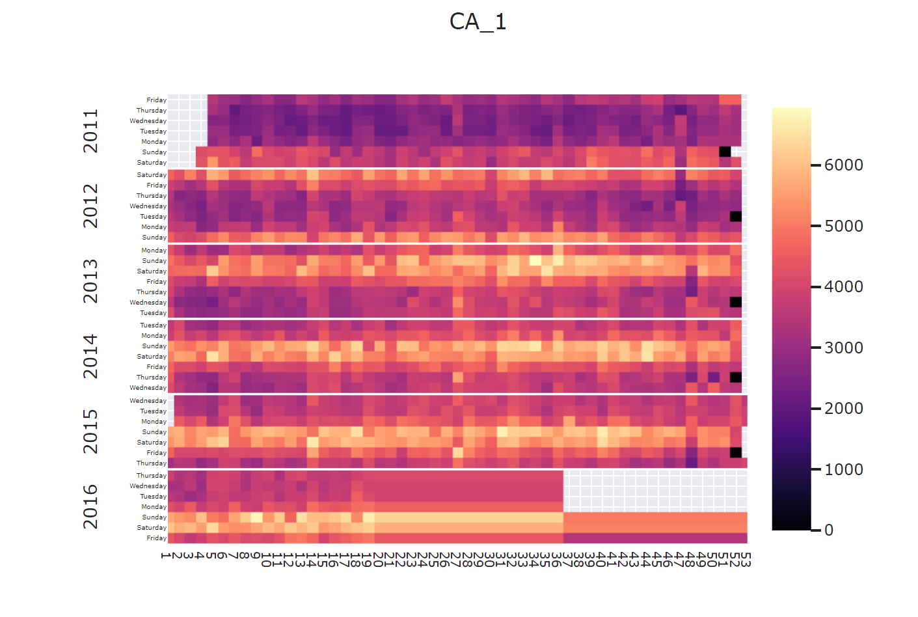
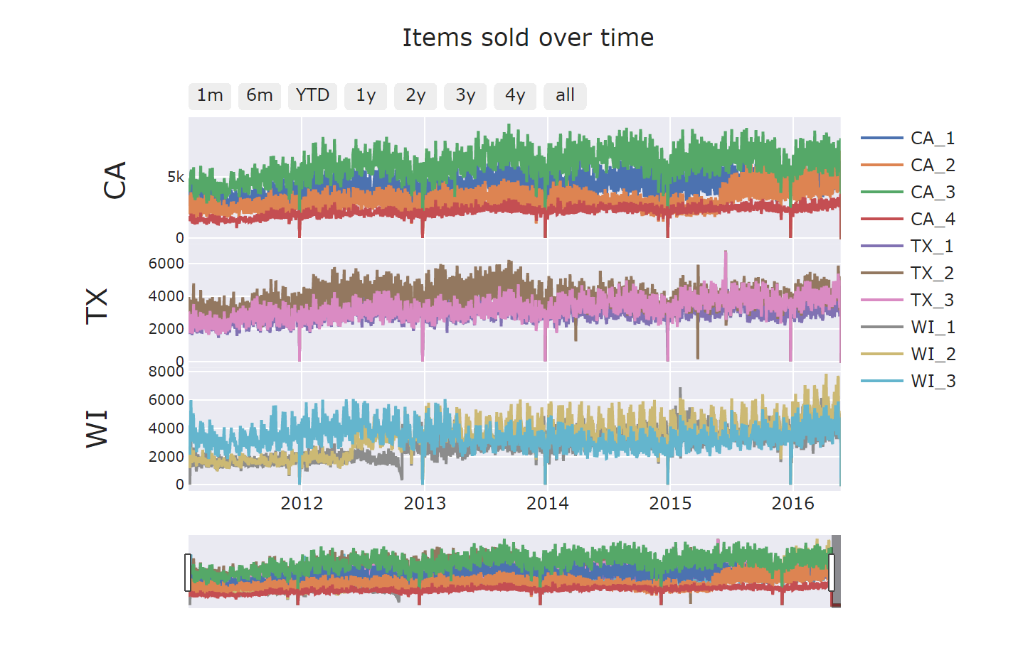
Walmart Sales Analysis
Walmart sales data - involves the unit sales of various products sold in the USA, organized in the form of grouped time series.
Heatmap to show daily sales.

Slide 17
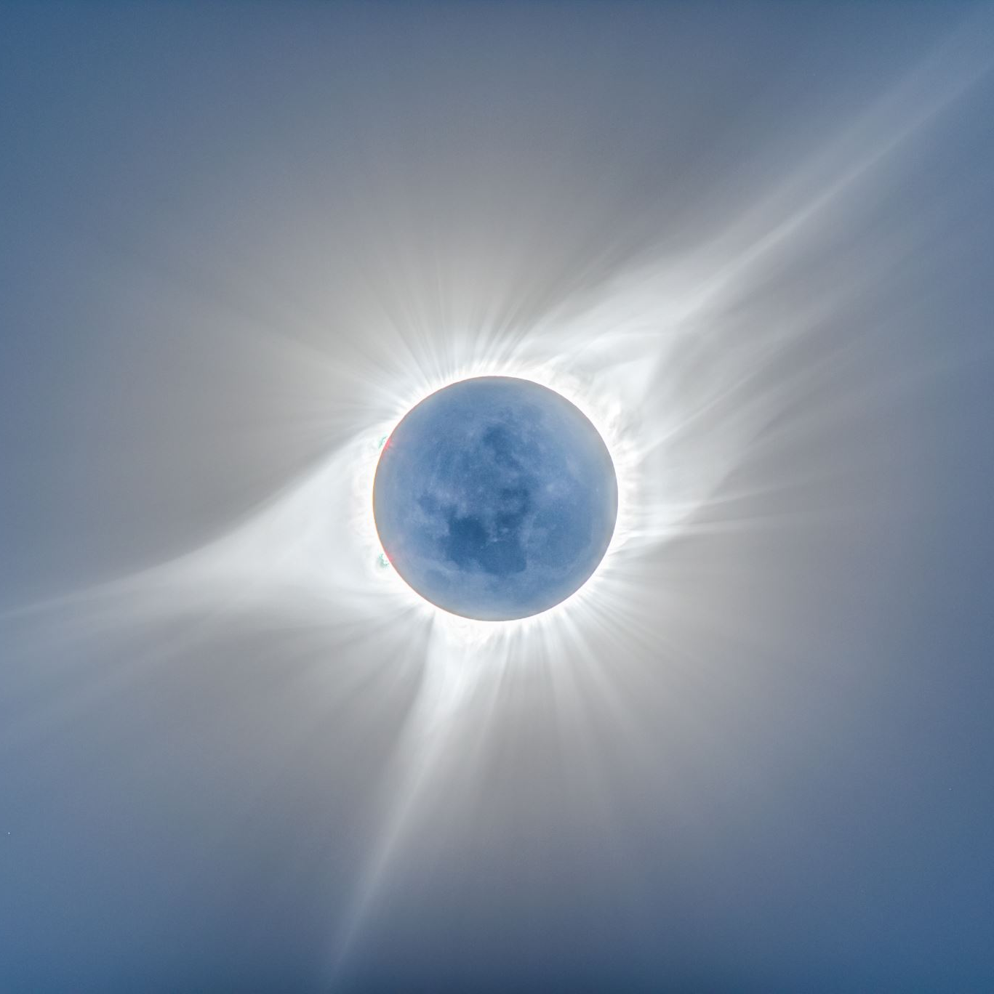
Diabetic Retinopathy Detection

Slide 18
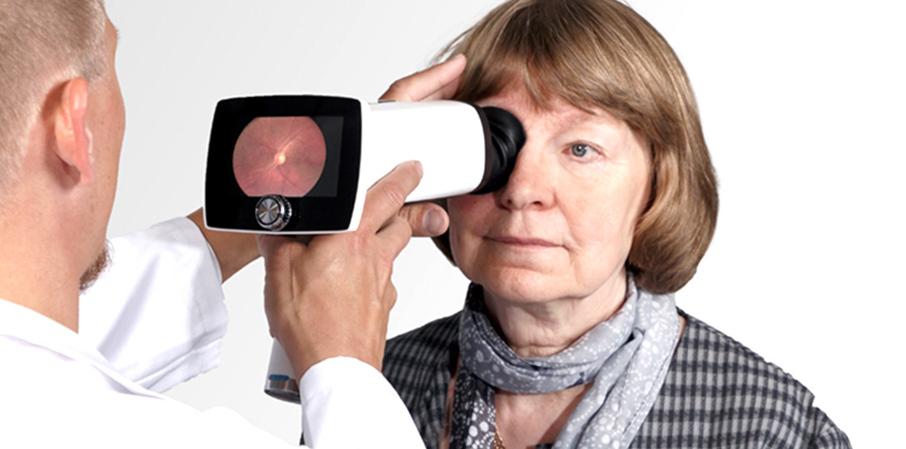
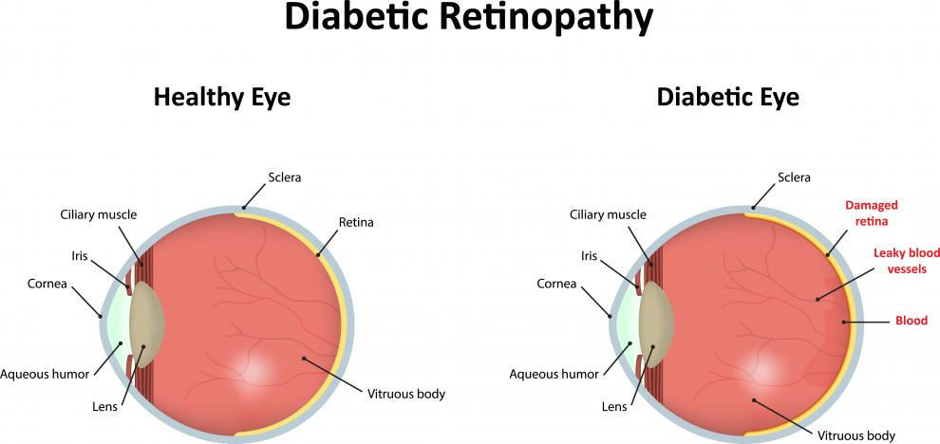
Problem Statement
Diabetic retinopathy is the leading cause of blindness in the working-age population of the developed world and is estimated to affect over 93 million people
Notes:
Currently, detecting DR is a timeconsuming and manual process that requires a trained clinician to examine and evaluate photographs of the retina. This poses a challenge in areas that traditionally lack access to skilled clinical facilities

Slide 19
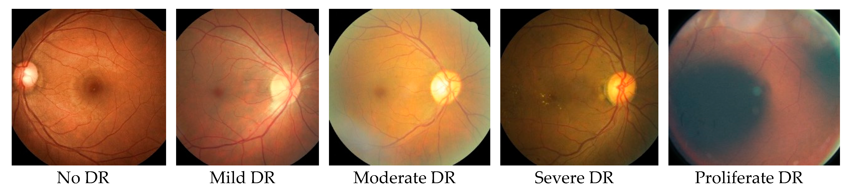
Dataset
California Healthcare Foundation 2015
35,000 images
Size 84GB
Notes:
Diabetic retinopathy images were acquired from a Kaggle dataset of 35,000 images of size 84GB (California Healthcare Foundation 2015)6. The dataset comprises high-resolution retina images taken under a variety of imaging conditions that vary in height and width between the low hundreds to low thousands of pixels.
The left and right fields are provided for every subject. Images are labeled with a subject id as well as either left or right. A clinician has rated the presence of diabetic retinopathy in each image on a scale of 0 to 4, according to the following scale:
0 - No DR 1 - Mild 2 - Moderate 3 - Severe 4 - Proliferative

Slide 20
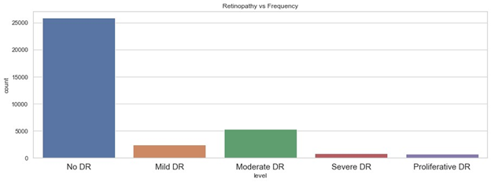
Dataset
We found that the classes were very imbalanced with 73% of data containing images with no severity (class 0)
Notes:
Disease Class 0 - 25,810 images Disease Class 1 - 2,443 images Disease Class 2 - 5,292 images Disease Class 3 - 873 images Disease Class 4 - 708 images

Slide 21
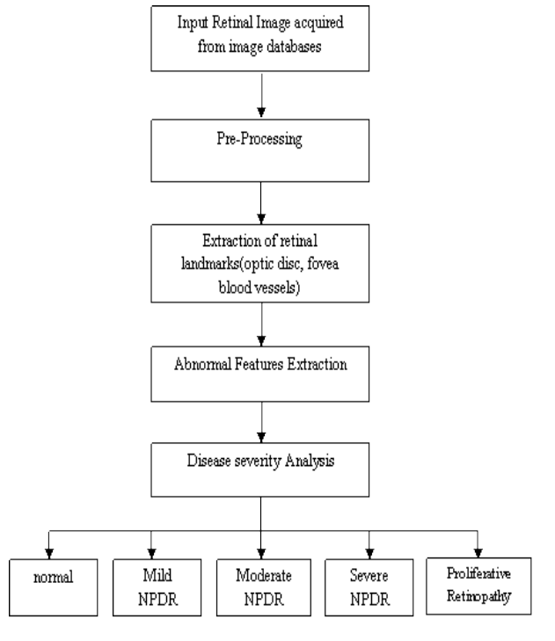
Approach & Methodology
Notes:
Our plan was to start with all the 35K images with 5 classes and build models using Google Colab. We first resized all the images to 500 by 500 pixels and trained our models and used data augmentation for populating other classes. Random Rotation: Picking a random degree of rotation between 25% on the left and 25% on the right
Random Noise: Adding random noise to the image
Horizontal Flip: Flipping the image array of pixels
Random Brightness: Adding brightness at various levels
Vertical Flip: Flipping the image array of pixels

Slide 22
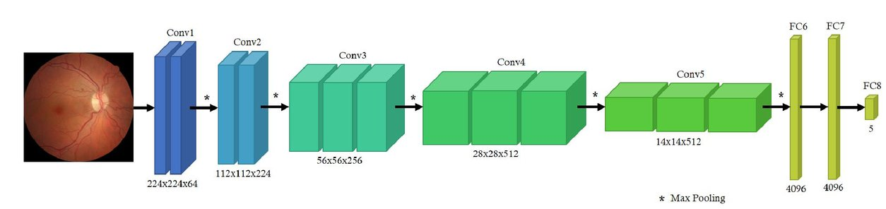
CNN
5 Conv Layers
3 Fully Connected layers

Slide 23
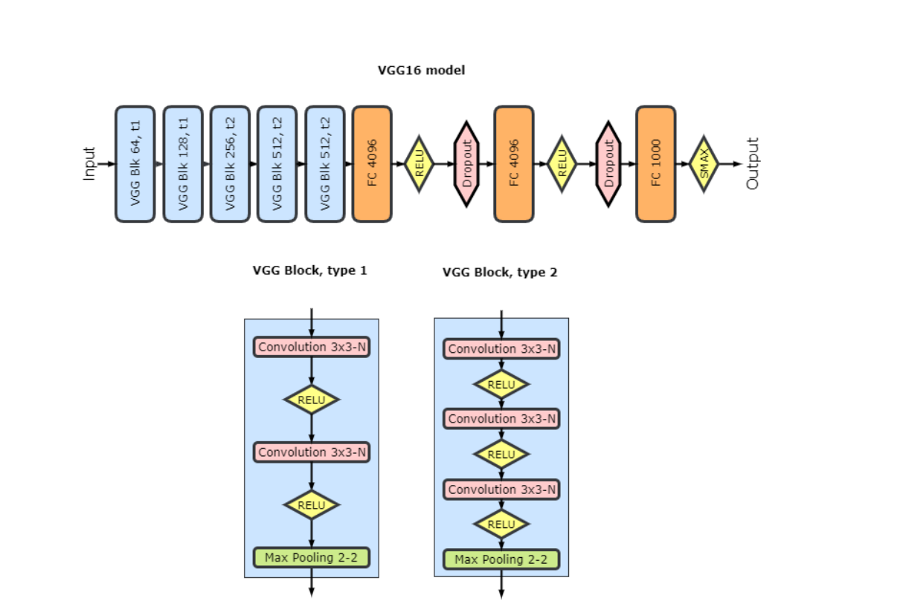
VGG16
Notes:
Training convolutional model 19 layers deep, with 8,013,393 parameters, on large 540x540 images represents significant challenge for convergence. We significantly redesigned original VGG architecture, added number of recent innovations and developed special training protocols to achieve better convergence and accuracy. More traditional techniques like dropout, data augmentation and preprocessing have been applied too. With these design choices, full end-to-end training is possible, and for a single model it takes several days on Kaggle data set on GPU Nvidia GTX-980.

Slide 24
Evaluation
Multi Class Classification | Accuracy | Precession
CNN | 81% | 75%
VGG16 | 89% | 90%
Binary Classification | Accuracy | Precession
CNN | 93% | 90%
VGG16 | 97% | 92%

Slide 25

Thank You

